Slide 1


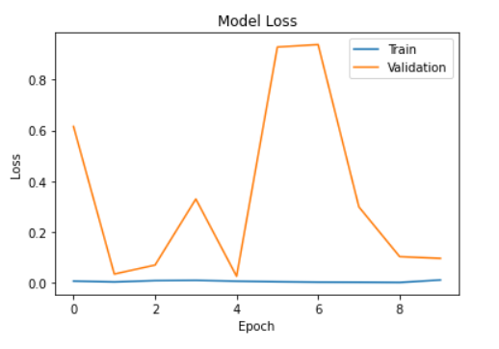
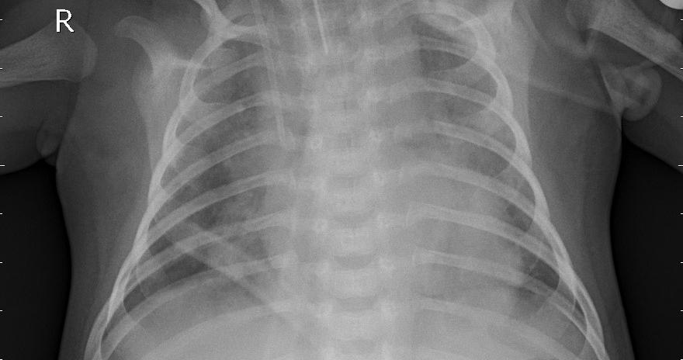
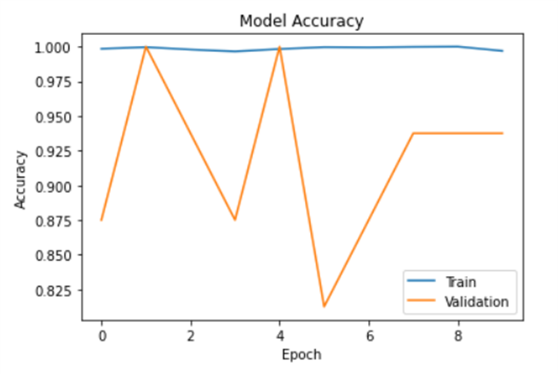
X-Ray diagnostics using Machine Learning Lavaneeth Reddy, Siddhartha Talasila Git:https://github.com/Siddharth181/X-Ray-Diagnostics-Using-machine-learning.git
ABSTRACT
The X-ray diagnostics project aims to develop a computerized system to detect abnormalities and anomalies in chest X-ray images, such as pneumonia.
The project will involve the collection and analysis of large datasets of chest X-ray images, the development of algorithms analysis, and the creation of the user-friendly interface to interact with the system
OBJECTIVE
Designing a system for detecting Pneumonia using chest X-ray images as an input.
Main objective is to achieve better accuracy than existing model
DATA
Dataset contains about 6000 image of chest X-ray
The dataset consists of training, testing and validation with 2 classes in each
NORMAL and PNEUMONIA are the classes of dataset.
RESULTS
This system give an accuracy of 99%
This accuracy is highest than existing models
METHODOLOGY
Data pre-processing and training has been done. In Jupiter notebook
CNN model is used in this system, model creation has been done on python.
User-interface i.e., the frontend is made using HTML.
CONCLUSION
This system can be an instant Pneumonia detecting. Or else in other words we can an easy diagnosis.
REFERENCES
[1] EMCNet: Automated COVID-19 diagnosis from X-ray images using convolutional neural network and ensemble of machine learning classifiers (2020).
[2] Pneumonia Diagnosis Using Chest X-ray Images and Machine Learning (2020).

